Slide 1
Introduction to SQL
— Chapter 3
2021年9月
叶文
yewen@bupt.edu.cn
School of Computer Science (National Pilot Software Engineering School)

Slide 2
Outline
Overview of The SQL Query Language
SQL Data Definition
Basic Query Structure of SQL Queries
Additional Basic Operations
Set Operations
Null Values
Aggregate Functions
Nested Subqueries
Modification of the Database
SQL history, background
domain types, definition and modification of schemas，DDL， by create/alter/drop——建立/定义数据库
by Select for query —查询数据库
by insert/update/update——修改/更新数据库

Slide 3
3.1 Overview of SQL
Structured Query Language
most widely used query language, commercially,
as the standard of database query languages，also extended into other areas, e.g. BigData
IBM Sequel language developed as part of System R project at the IBM San Jose Research Laboratory
Renamed Structured Query Language (SQL)
ANSI and ISO standard SQL:
SQL-86, SQL-89, SQL-92
SQL:1999 (language name became Y2K compliant!)
SQL:2003/2008, with the ability to process XML data
Commercial systems offer most, if not all, SQL-92 features, plus varying feature sets from later standards and special proprietary features.
Not all examples here may work on your particular system.

Slide 4
SQL Parts
DML -- provides the ability to query information from the database and to insert tuples into, delete tuples from, and modify tuples in the database
query/retrieve, insert , delete, update
Data definition language (DDL)
define, drop, modify on schemas, views and index
DDL: integrity
the DDL includes commands for specifying integrity constraints.
DDL: View definition
The DDL includes commands for defining views.
Transaction control
includes commands for specifying the beginning and ending of transactions.
Embedded SQL and dynamic SQL
define how SQL statements can be embedded within general-purpose programming languages.
Authorization – includes commands for specifying access rights to relations and views.

Slide 5
data query | Select
data manipulation | Insert, Delete, Update
data definition | Create, Drop, Alter (on schema)
data control | Grant, Revoke (in Chapter 4)
transaction processing | begin transaction, commit, rollback
指针/游标控制语言（CCL） | DECLARE CURSOR，FETCH INTO和UPDATE WHERE CURRENT

Slide 6
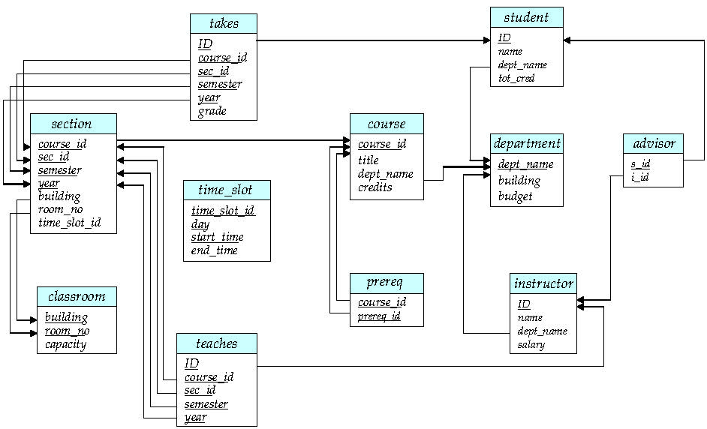
University Database
r₂
r₁
Fig. 2.9 Schema Diagram

Slide 7
3.2 SQL Data Definition
The SQL data-definition language (DDL) allows the specification of information about relations, including:
The schema for each relation.
The type of values associated with each attribute.
The Integrity constraints
The set of indices to be maintained for each relation.
Security and authorization information for each relation
The physical storage structure of each relation on disk

Slide 8
Domain Types in SQL
char(n). Fixed length character string, with user-specified length n.
varchar(n). Variable length character strings, with user-specified maximum length n.
int. Integer (a finite subset of the integers that is machine-dependent).
smallint. Small integer (a machine-dependent subset of the integer domain type).
numeric(p,d). Fixed point number, with user-specified precision of p digits, with d digits to the right of decimal point. (ex., numeric(3,1), allows 44.5 to be stores exactly, but not 444.5 or 0.32)
real, double precision. Floating point and double-precision floating point numbers, with machine-dependent precision.
float(n). Floating point number, with user-specified precision of at least n digits

Slide 9
Domain Types in SQL
date. Dates, containing a (4 digit) year, month and date
E.g. date ‘2001-7-27’
time. Time of day, in hours, minutes and seconds.
E.g. time ’09:00:30’ time ’09:00:30.75’
timestamp: date plus time of day
E.g. timestamp ‘2001-7-27 09:00:30.75’
Interval: period of time
E.g. Interval ‘1’ day
Subtracting a date/time/timestamp value from another gives an interval value
Interval values can be added to date/time/timestamp values
Null values are allowed in all the domain types. Declaring an attribute to be not null prohibits null values for that attribute.
create domain construct in SQL-92 creates user-defined domain types 自定义类型
create domain person-name char(20) not null

Slide 10
注意
在Oracle, DB2等大型商用数据库系统中，关系表的属性的名字只能取英文名，不支持中文属性名
Why ?!
SQL Server支持中英文属性名
开发大型数据库应用时，程序所访问的关系表的属性名字（最好）取为英文名，便于应用程序的可移植性！
准确表示英文专业术语（英文属性名称), e.g. 分组 packet

Slide 11
Baisc Schema Definition: Create Table
An SQL relation is defined using the create table command:
create table r
(A₁ D₁, A₂ D₂, ..., A_{n} D_{n}, (integrity-constraint₁), ..., (integrity-constraint_{k}))
r is the name of the relation
each A_{i} is an attribute name in the schema of relation r
D_{i} is the data type of values in the domain of attribute A_{i}
Example:
create table instructor ( ID char(5), name varchar(20), dept_name varchar(20), salary numeric(8,2))

Slide 12
Integrity Constraints in Create Table
Types of integrity constraints
primary key (A₁, ..., A_{n} )
foreign key (A_{m}, ..., A_{n} ) references r
not null
SQL prevents any update to the database that violates an integrity constraint.
Example:
create table instructor ( ID char(5), name varchar(20) not null, dept_name varchar(20), salary numeric(8,2), primary key (ID), foreign key (dept_name) references department);

Slide 13
More Relation Definitions
create table student ( ID varchar(5), name varchar(20) not null, dept_name varchar(20), tot_cred numeric(3,0), primary key (ID),
foreign key (dept_name) references department);
create table takes ( ID varchar(5), course_id varchar(8), sec_id varchar(8), semester varchar(6), year numeric(4,0), grade varchar(2),
primary key (ID, course_id, sec_id, semester, year) ,
foreign key (ID) references student, foreign key (course_id, sec_id, semester, year) references section);

Slide 14
Updates to Schemas
Drop Table
drop table r
Alter
alter table r add A D
where A is the name of the attribute to be added to relation r and D is the domain of A.
All exiting tuples in the relation are assigned null as the value for the new attribute
E.g. alter table student add age integer
alter table r drop A
where A is the name of an attribute of relation r
E.g. alter table student drop age
Dropping of attributes not supported by many databases-why？

Slide 15
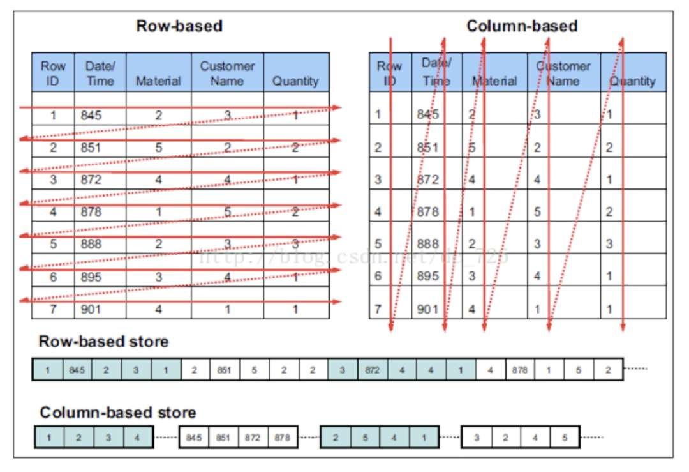
The tuples/rows in a relational table are stored row by row in the database file on disk(按行存储). Thus, adding the attributes into or dropping from the table leads to costly modifying the existing records in the file and then moving these records on the disk
NoSQL DB
BigData, 大数据，按列存储
store data column by column

Slide 16
3.3 Basic Structure of SQL Queries
A typical SQL query has the form: select A₁, A₂, ..., A_{n} from r₁, r₂, ..., r_{m} where P
A_{i} represents an attribute
R_{i} represents a relation
P is a predicate.
The result of an SQL query is a relation
This query is equivalent to the relational algebra expression
∏ _{A1, A2, ..., An}(σ_{P} (r₁ x r₂ x ... x r_{m}))
query result :
A₁ | A₂ | … | … | A_{n}
* | * | * | * | *
* | * | * | * | *
* | * | * | * | *
* | * | * | * | *
* | * | * | * | *
t₁
t₂
t_{k}

Slide 17
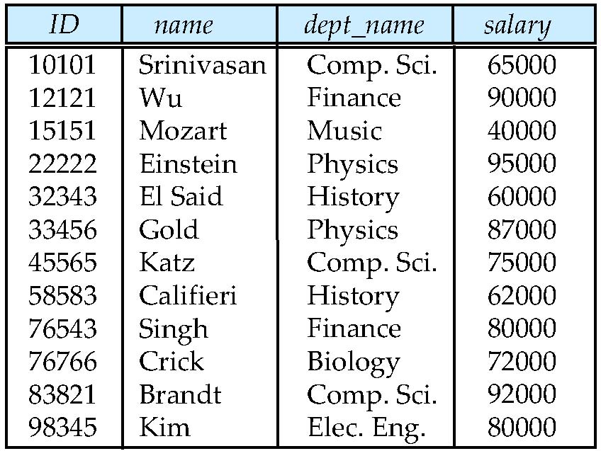
The select Clause
The select clause lists the attributes desired in the result of a query
corresponds to the projection operation of the relational algebra
Example: find the names of all instructors: select name from instructor
attributes
(or columns)
tuples
(or rows)
NOTE: SQL names are case insensitive (i.e., you may use upper- or lower-case letters.)
E.g., Name ≡ NAME ≡ name
Some people use upper case wherever we use bold font
t₂

Slide 18
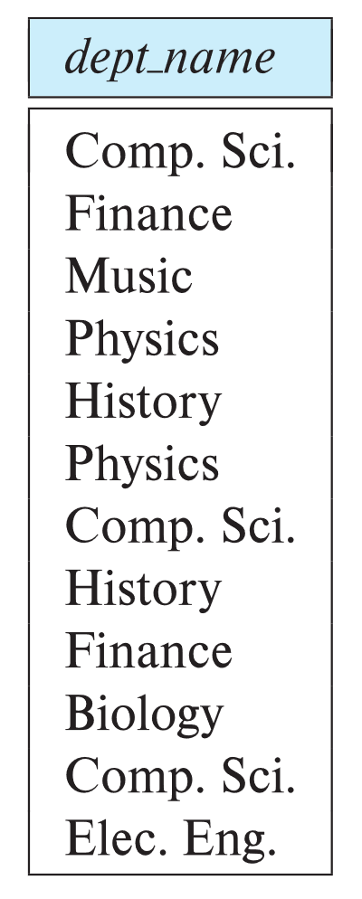
The select Clause
SQL allows duplicates in relations as well as in query results.
To force the elimination of duplicates, insert the keyword distinct after select.
Find the department names of all instructors, and remove duplicates
select distinct dept_name from instructor
The keyword all specifies that duplicates should not be removed.
select all dept_name from instructor

Slide 19
Duplicate Q&A
Which one is right ?
? select distinct A1, A2, A3 from r
where …
? select distinct A1, distinct A2 from r
where …
? select distinct (A1, A2), … from r
where …

Slide 20
The select Clause (Cont.)
An asterisk in the select clause denotes “all attributes”
select * from instructor
An attribute can be a literal with no from clause
select '437'
Results is a table with one column and a single row with value “437”
Can give the column a name using:
select '437' as FOO
An attribute can be a literal with from clause
select 'A' from instructor
Result is a table with one column and N rows (number of tuples in the instructors table), each row with value “A”
实际应用中避免在select子句中使用*，防止索引失效
437
FOO
437
A
A
…
A
A

Slide 21
The select Clause (Cont.)
The select clause can contain arithmetic expressions involving the operation, +, –, ∗, and /, and operating on constants or attributes of tuples.
The query:
select ID, name, salary/12 from instructor
would return a relation that is the same as the instructor relation, except that the value of the attribute salary is divided by 12.
Can rename “salary/12” using the as clause:
select ID, name, salary/12 as monthly_salary

Slide 22
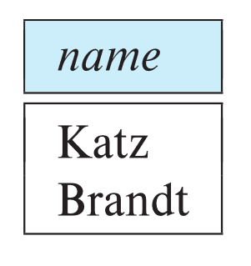
The where Clause
The where clause specifies conditions that the result must satisfy
Corresponds to the selection predicate of the relational algebra.
To find all instructors in Comp. Sci. dept
select name from instructor where dept_name = 'Comp. Sci.'
SQL allows the use of the logical connectives and, or, and not
The operands of the logical connectives can be expressions involving the comparison operators <, <=, >, >=, =, and <>.
Comparisons can be applied to results of arithmetic expressions
To find all instructors in Comp. Sci. dept with salary > 70000
select name from instructor where dept_name = 'Comp. Sci.' and salary > 70000

Slide 23
Where Clause Predicates
SQL includes a between comparison operator
Example: Find the names of all instructors with salary between $90,000 and $100,000 (that is, ≥ $90,000 and ≤ $100,000)
select name from instructor where salary between 90000 and 100000
Tuple comparison
select name, course_id from instructor, teaches where (instructor.ID, dept_name) = (teaches.ID, 'Biology');

Slide 24
The from Clause
The from clause lists the relations involved in the query
Corresponds to the Cartesian product operation of the relational algebra.
Find the Cartesian product instructor X teaches
select ∗ from instructor, teaches
generates every possible instructor – teaches pair, with all attributes from both relations.
For common attributes (e.g., ID), the attributes in the resulting table are renamed using the relation name (e.g., instructor.ID)
Cartesian product not very useful directly, but useful combined with where-clause condition (selection operation in relational algebra)

Slide 25
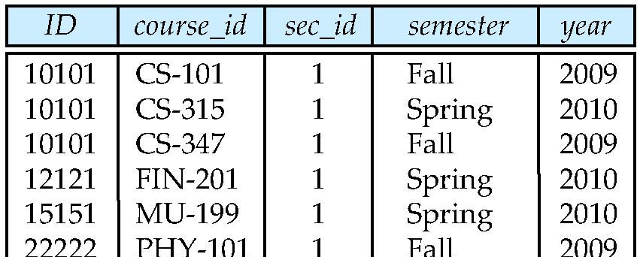
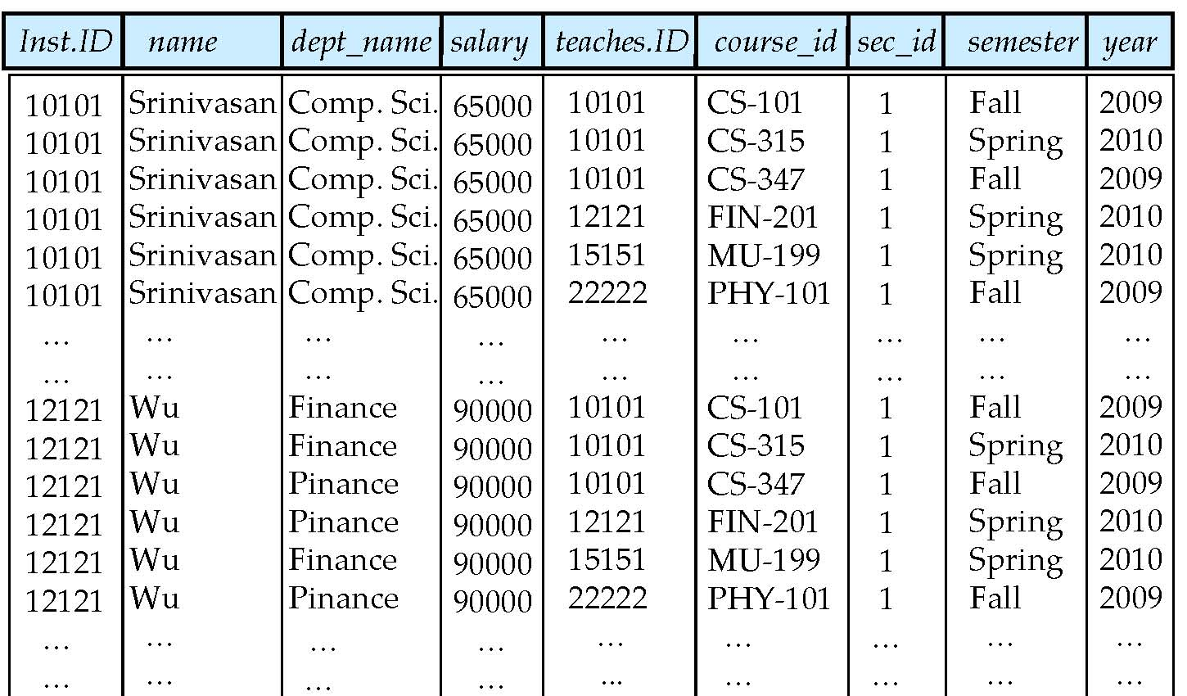
Cartesian Product
instructor
teaches

Slide 26
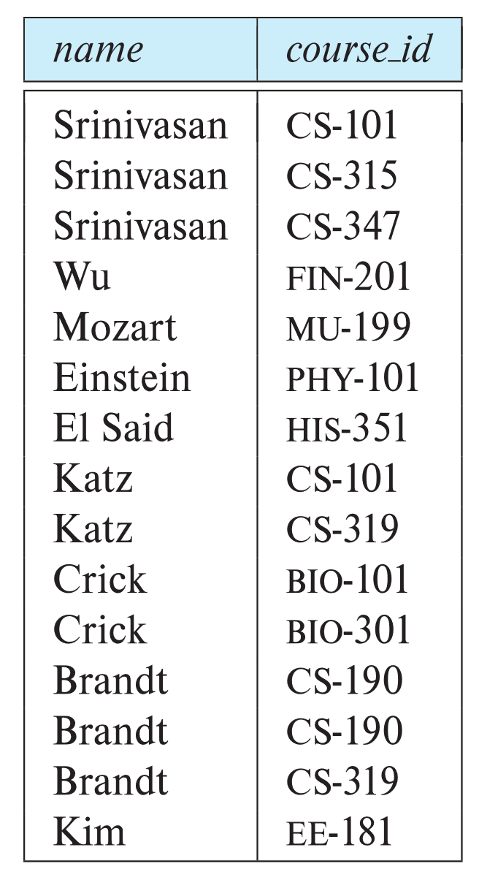
Examples
Find the names of all instructors who have taught some course and the course_id
select name, course_id from instructor , teaches where instructor.ID = teaches.ID
Find the names of all instructors in the Art department who have taught some course and the course_id
select name, course_id from instructor , teaches where instructor.ID = teaches.ID and instructor. dept_name = 'Art'

Slide 27
注意事项
from 子句中包括多个关系表时，一定要在where子句中加入连接条件
防止出现costly多表笛卡尔积操作
实际应用中，对频繁执行的SQL查询，其from子句中的表的个数不要过多，如不要超过4个！
避免耗时费力的多表连接操作
如果频繁执行的SQL查询涉及的查询数据存放在N≥4张表中，可以考虑将这N张表中的数据进行合并

Slide 28
natural join
SQL also supports “natural join” in the from subclause
E.g. Find the names of all instructors in the Art department who have taught some course and the course_id
select name, course_id from instructor natural join teaches where instructor. dept_name = ‘Art’
Compared with:
select name, course_id from instructor, teaches where instructor.ID = teaches.ID
and instructor. dept_name = ‘Art’

Slide 29
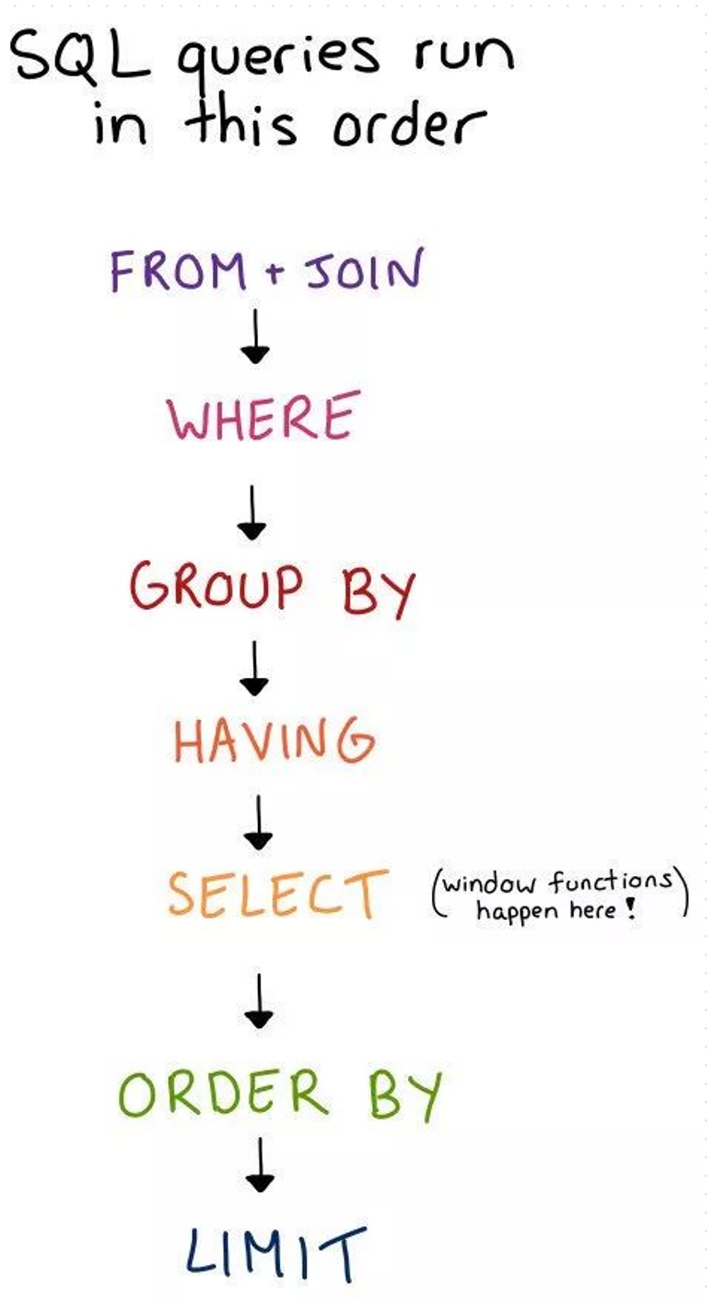
SQL Syntax
Select {ALL | DISTINCT } <column expression1> {,
<column expression1> }
From <table_name or view_name> {,
<table_name or view_name> }
{ Where < conditional expression1 > }
{ Group by < column_name1 >
Having{ < conditional expression2 > } }
{ Order by <column_name2 > { ASC | DESC } }

Slide 30
Computation Procedure of Select
selecting tuples that satisfy conditions defined by where sub_clause from base tables or views listed in from sub_clause
according to column expression listed in select sub_clause, selecting attributes from these tuples , and forming a result table as query result
if group sub_clause exist, grouping the result table on the basis of conditional expression2 , conducting group/aggregate functions on each groups, and outputting every groups as query results.
if Having appears, only outputting groups that satisfy column_name1 as query results.
if order sub_clause exist, sorting the result table or groups in descending or ascending orders.
if distinct appears in select sub_clause , eliminating duplicates of tuples in the result table.

Slide 31
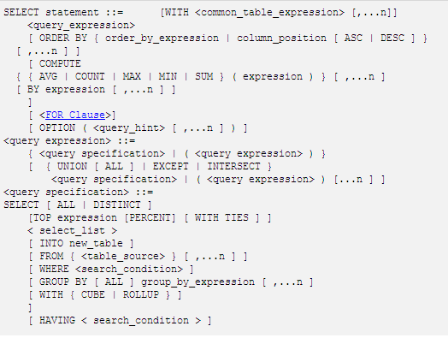
Select in SQL Server

Slide 32
3.4 Additional Basic Operation：The Rename Operation
The SQL allows renaming relations and attributes using the as clause:
old-name as new-name
Find the names of all instructors who have a higher salary than some instructor in 'Comp. Sci'.
select distinct T.name as TeacherName from instructor as T, instructor as S /*tuple variable，元组变量 where T.salary > S.salary and S.dept_name = 'Comp. Sci.’
Keyword as is optional and may be omitted: instructor as T ≡ instructor T
T
T.name
T.salary
S
S.name
S.dept_name
S.salary
return

Slide 33
Tuple Variables
涉及到对instructor关系中属性salary的不同值的比较
select distinct T.name from instructor as T, instructor as S where T.salary > S.salary and S.dept_name = ‘Comp. Sci.’
’
/*利用T和S区分不同的instructor!!!!!, 实现了对同一属性的不同值的比较

Slide 34
String Operations
SQL includes a string-matching operator for comparisons on character strings. The operator like uses patterns that are described using two special characters:
percent ( % ). The % character matches any substring.
underscore ( _ ). The _ character matches any character.
Find the names of all instructors whose name includes the substring “dar”.
select name from instructor where name like '%dar%'
Match the string “100%”
like '100 \%' escape '\'
in that above we use backslash (\) as the escape character.

Slide 35
String Operations (Cont.)
Patterns are case sensitive.
Pattern matching examples:
'Intro%' matches any string beginning with “Intro”.
'%Comp%' matches any string containing “Comp” as a substring.
'_ _ _' matches any string of exactly three characters.
'_ _ _ %' matches any string of at least three characters.
SQL supports a variety of string operations such as
concatenation (using “||”)
converting from upper to lower case (and vice versa)
finding string length, extracting substrings, etc.

Slide 36
Attribute Specification in the Select Clause
* denotes all attributes
select instructor.* from instructor , teaches where instructor.ID = teaches.ID

Slide 37
Ordering the Display of Tuples
List in alphabetic order the names of all instructors
select distinct name from instructor order by name
We may specify desc for descending order or asc for ascending order, for each attribute; ascending order is the default.
Example: order by name desc
Can sort on multiple attributes
Example: order by dept_name, name
Example: order by dept_name asc, name desc
知乎帖子：
一个程序员的水平能差到什么程度：生产环境下，用DB order by操作对大数据文件进行排序

Slide 38
3.5 Set Operations
Set operations union, intersect, and except operate on relations and correspond to the relational algebra operators ∪, ∩, and −
each of the above operations automatically eliminates duplicates
to retain all duplicates use the corresponding multiset versions union all, intersect all and except all
Find courses that ran in Fall 2017 or in Spring 2018
(select course_id from section where sem = 'Fall' and year = 2017) union (select course_id from section where sem = 'Spring' and year = 2018)
Find courses that ran in Fall 2017 and in Spring 2018
(select course_id from section where sem = 'Fall' and year = 2017) intersect (select course_id from section where sem = 'Spring' and year = 2018)

Slide 39
Set Operations
Find courses that ran in Fall 2017 but not in Spring 2018
(select course_id from section where sem = 'Fall' and year = 2017) except (select course_id from section where sem = 'Spring' and year = 2018)

Slide 40
3.6 Null Values
It is possible for tuples to have a null value, denoted by null, for some of their attributes
null signifies
an unknown value, or
that a value does not exist.
The result of any arithmetic expression involving null is null
Example: 5 + null returns null
The predicate is null can be used to check for null values.
Example: Find all instructors whose salary is null.
select name from instructor where salary is null
The predicate is not null succeeds if the value on which it is applied is not null.

Slide 41
Null Values (Cont.)
SQL treats as unknown the result of any comparison involving a null value (other than predicates is null and is not null).
Example: 5 < null or null <> null or null = null
The predicate in a where clause can involve Boolean operations (and, or, not); thus the definitions of the Boolean operations need to be extended to deal with the value unknown.
and : (true and unknown) = unknown, (false and unknown) = false, (unknown and unknown) = unknown
or: (unknown or true) = true, (unknown or false) = unknown (unknown or unknown) = unknown
Result of where clause predicate is treated as false if it evaluates to unknown
注意：
实际应用中避免引入属性null，防止索引失效；
用default value替代

Slide 42
3.7 Aggregate Functions
These functions operate on the multiset of values of a column of a relation, and return a value
avg: average value min: minimum value max: maximum value sum: sum of values count: number of values
How to conduct group by subclause and aggregate function
Select {A₁, A₂, ., A_{i}}, ag_fun(A_{i+1}),…, ag_fun(A_{i+k})
From r₁, r₂, ..., r_{m}
Where P₁
{ Group by A₁, A₂, ., A_{i}
{ having P₂ } }
P₁ is defined on all attributes of r₁, r₂, ..., r_{m}
P₂ is defined on A₁, A₂, ., A_{i},.., A_{j} ,… , A_{k}, …, A_{n}, as the constraints on the group formed by Group by A₁, A₂, A_{j}
attributes in the select clause outside of aggregate functions must appear in group by list

Slide 43
Examples
Find the average salary of instructors in the Computer Science department
select avg (salary) from instructor where dept_name= 'Comp. Sci.’;
Find the total number of instructors who teach a course in the Spring 2018 semester
select count (distinct ID) from teaches where semester = 'Spring' and year = 2018;
Find the number of tuples in the course relation
select count (*) from course;
ID | name | dept_name | salary
45565 | Jian | Comp. Sci | $100
74281 | Ye | Comp. Sci | $250
98753 | Du | Comp. Sci | $340
54123 | Lin | Comp. Sci | $200
avg

Slide 44
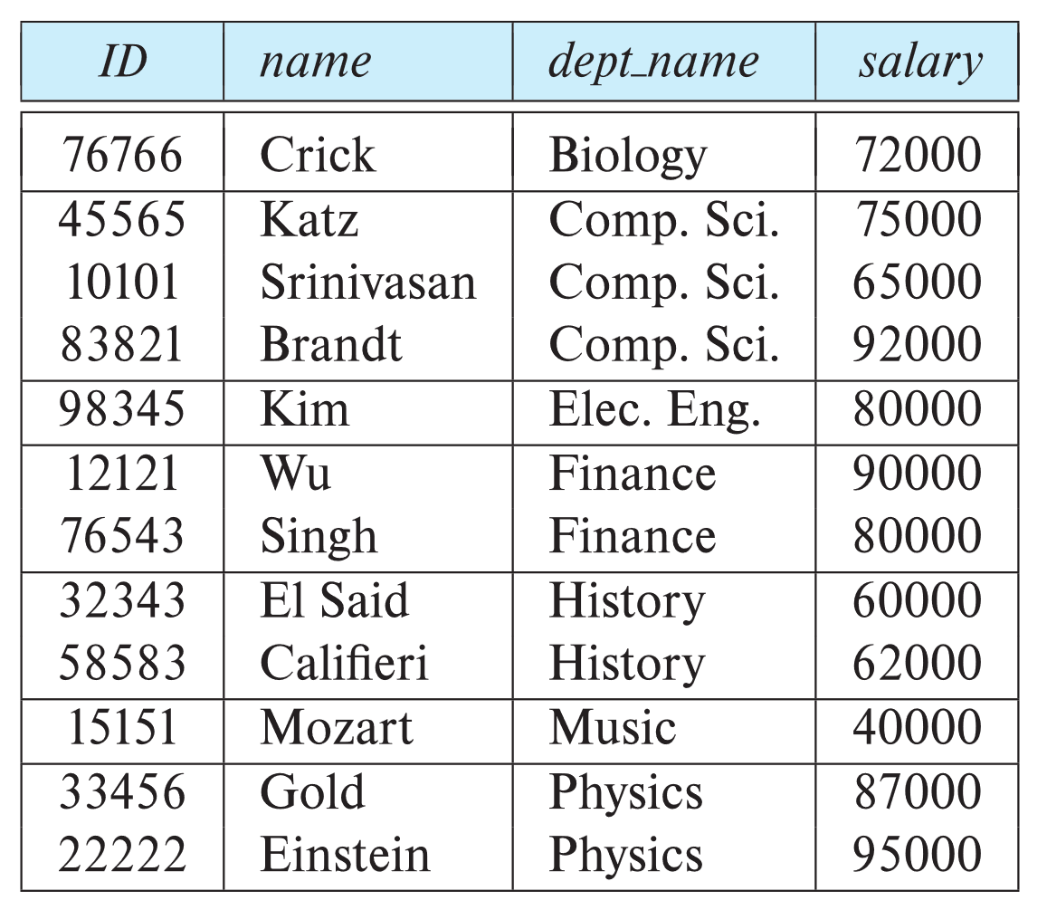
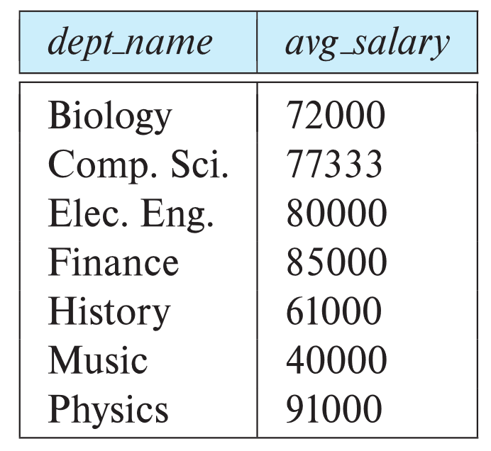
Aggregate Functions – Group By
Find the average salary of instructors in each department
select dept_name, avg (salary) as avg_salary from instructor group by dept_name;

Slide 45
Aggregation (Cont.)
Attributes in select clause outside of aggregate functions must appear in group by list
/* erroneous query */ select dept_name, ID, avg (salary) from instructor group by dept_name
Null values and aggregates
all aggregate operations except count(*) ignore tuples with null values on the aggregated attributes

Slide 46
Aggregate Functions – Having Clause
Find the names and average salaries of all departments whose average salary is greater than 42000
Note: predicates in the having clause are applied after the formation of groups whereas predicates in the where clause are applied before forming groups
select dept_name, avg (salary) as avg_salary
from instructor
group by dept_name
having avg (salary) > 42000;

Slide 47
3.8 Nested Subqueries
SQL provides a mechanism for the nesting of subqueries. A subquery is a select-from-where expression that is nested within another query.
The nesting can be done in the following SQL query select A₁, A₂, ..., A_{n} from r₁, r₂, ..., r_{m} where P
as follows:
From clause: r_{i} can be replaced by any valid subquery
Where clause: P can be replaced with an expression of the form:
B <operation> (subquery)
B is an attribute and <operation> to be defined later.
Select clause:
A_{i} can be replaced be a subquery that generates a single value
嵌套查询： 中间结果，便于构思化大为小， 化繁为简。
DBMS实现时，要优化，不一定要保留中间值
注意：
从SQL优化角度，避免使用低效的nested查询，改为from子句中的多表联接，便于DBMS查询优化

Slide 48
Set Membership
Find courses offered in Fall 2017 and in Spring 2018
Find courses offered in Fall 2017 but not in Spring 2018
SQL优化:：
转换为from 中的2表联接
select …
from section as A, section as B
where …
select distinct course_id
from section
where semester = 'Fall' and year= 2017 and course_id in (select course_id
from section
where semester = 'Spring' and year= 2018);
select distinct course_id
from section
where semester = 'Fall' and year= 2017 and course_id not in (select course_id
from section
where semester = 'Spring' and year= 2018);

Slide 49
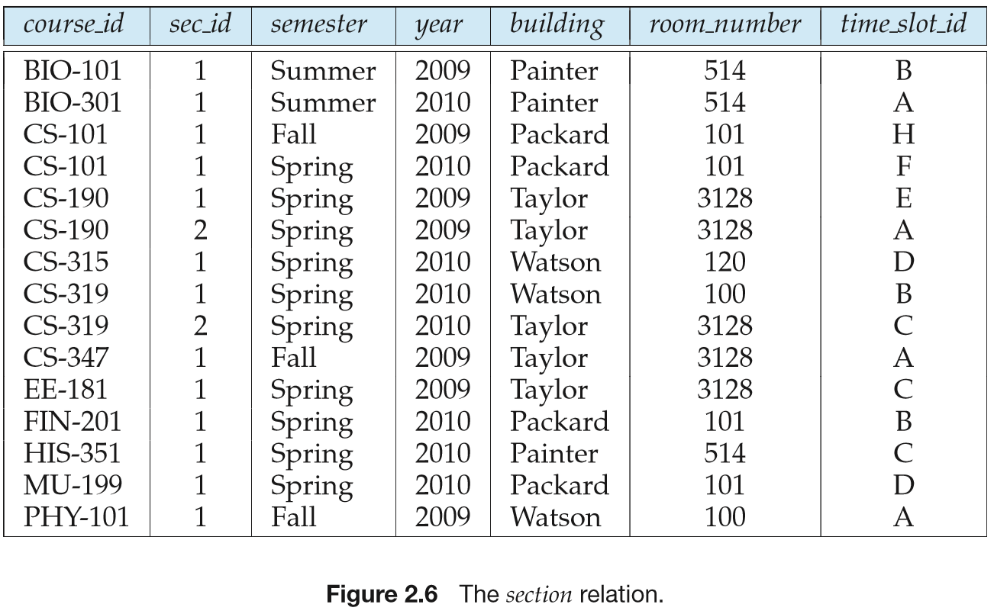
嵌入式查询执行过程
1. 从头至尾，依次扫描section中每一行；
2. 对section中每一行，
a. 判断其semester、year是否满足查询条件
b. 执行嵌入在where子句中的select查询，得到10年春季的course_id集 合；
3. 判断本行的course_id是否在此集合中，决定本行的course_id是否所需查询结果

Slide 50
嵌入式查询执行过程
说明
上述语句的有可能执行效率较低，why?!
被嵌入的select子句可能多次重复执行
实际应用中应尽量避免membership等嵌入式查询，参见“数据库物理设计及查询优化”

Slide 51
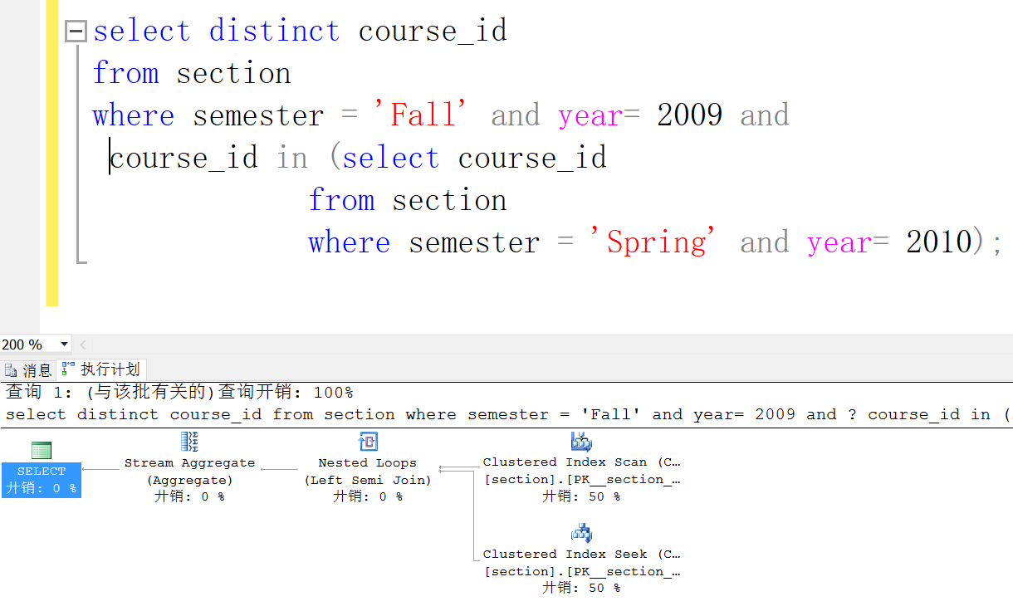
嵌入式查询的查询执行计划

Slide 52
Set Membership (Cont.)
Name all instructors whose name is neither “Mozart” nor Einstein”
select distinct name
from instructor
where name not in ('Mozart', 'Einstein')
Find the total number of (distinct) students who have taken course sections taught by the instructor with ID 10101
Note: Above query can be written in a much simpler manner. The formulation above is simply to illustrate SQL features
students, takes, teaches
select count (distinct ID)
from takes
where (course_id, sec_id, semester, year) in (select course_id, sec_id, semester, year
from teaches
where teaches.ID= 10101)
语句的执行效率较低，why?!
被嵌入的select子句可能多次重复执行

Slide 53
Set Comparison – “some” Clause
Find names of instructors with salary greater than that of some (at least one) instructor in the Biology department.
Same query using > some clause
select distinct T.name
from instructor as T, instructor as S
where T.salary > S.salary and S.dept name = 'Biology';
优于
select name
from instructor
where salary > some (select salary
from instructor
where dept name = 'Biology');

Slide 54
Definition of “some” Clause
F <comp> some r ⇔ ∃ t ∈ r such that (F <comp> t ) Where <comp> can be: <, ≤, >, =, ≠
0
(5 < some
5
) = true
(read: 5 < some tuple in the relation)
6
0
(5 < some
5
) = false
0
(5 = some
) = true
5
0
(5 ≠ some
5
) = true (since 0 ≠ 5)
(= some) ≡ in
However, (≠ some) ≡ not in

Slide 55
Set Comparison – “all” Clause
Find the names of all instructors whose salary is greater than the salary of all instructors in the Biology department.
select name
from instructor
where salary > all (select salary
from instructor
where dept name = 'Biology')

Slide 56
Definition of “all” Clause
F <comp> all r ⇔ ∀ t ∈ r (F <comp> t)
0
(5 < all
5
) = false
6
6
(5 < all
) = true
10
4
(5 = all
) = false
5
4
(5 ≠ all
) = true (since 5 ≠ 4 and 5 ≠ 6)
6
(≠ all) ≡ not in
However, (= all) ≡ in

Slide 57
Test for Empty Relations
The exists construct returns the value true if the argument subquery is nonempty
exists r ⇔ r ≠ Ø
not exists r ⇔ r = Ø
集合包含
except: X – Y
X – Y = Ø ⇔ X ⊆ Y
X ⊆ Y ⇔ ( X – Y ) = Ø ⇔ not exists ( X except Y )
E.g. Find all students who take all the courses that takes by Li
/查询选修了“Li”所选修的全部课程的同学
1. 计算Li选修课程集合X
2. 对每个学生，计算他选修的课程集合Y
3. 判断Y是否包含X

Slide 58
Use of “exists” Clause
Yet another way of specifying the query “Find all courses taught in both the Fall 2017 semester and in the Spring 2018 semester”
select course_id from section as S where semester = 'Fall' and year = 2017 and exists (select * from section as T where semester = 'Spring' and year= 2018 and S.course_id = T.course_id);
Correlation name – variable S in the outer query
Correlated subquery – the inner query

Slide 59
Use of “not exists” Clause
Find all students who have taken all courses offered in the Biology department
Note that X – Y = Ø ⇔ X ⊆ Y
Note: Cannot write this query using = all and its variants
select distinct S.ID, S.name
from student as S
where not exists ( (select course_id
from course
where dept_name = 'Biology')
except
(select T.course_id
from takes as T
where S.ID = T.ID));
First nested query lists all courses offered in Biology
Second nested query lists all courses a particular student took
X： all courses offered in
the Biology department
Y

Slide 60
Test for Absence of Duplicate Tuples
The unique construct tests whether a subquery has any duplicate tuples in its result.
The unique construct evaluates to “true” if a given subquery contains no duplicates .
Find all courses that were offered at most once in 2017
select T.course_id from course as T where unique ( select R.course_id from section as R where T.course_id= R.course_id and R.year = 2017)

Slide 61
Subqueries in the From Clause
SQL allows a subquery expression to be used in the from clause
Find the average instructors’ salaries of those departments where the average salary is greater than $42,000.”
select dept_name, avg_salary from ( select dept_name, avg (salary) as avg_salary from instructor group by dept_name) where avg_salary > 42000
Note that we do not need to use the having clause
Another way to write above query
select dept_name, avg_salary from ( select dept_name, avg (salary) from instructor group by dept_name)
as dept_avg (dept_name, avg_salary)
where avg_salary > 42000

Slide 62
With Clause——建议优先使用
The with clause provides a way of defining a temporary relation whose definition is available only to the query in which the with clause occurs.
将1个复杂查询分解为若干步，每个视图定义1个各步的中间计算结果，逻辑清晰
Find all departments with the maximum budget with max_budget (value) as (select max(budget) from department) select department.name from department, max_budget where department.budget = max_budget.value;
找出所有最高budget的department（可能不只一个
视图max-budget(value) = { 200000}, e.g.
定义局部视图
//取子集作为中间逻辑结果

Slide 63
Complex Queries using With Clause
Find all departments where the total salary is greater than the average of the total salary at all departments
with dept _total (dept_name, value) as
(select dept_name, sum(salary)
from instructor
group by dept_name),
dept_total_avg(value) as
(select avg(value)
from dept_total)
select dept_name
from dept_total, dept_total_avg
where dept_total.value > dept_total_avg.value;

Slide 64
Scalar Subquery
Scalar subquery is one which is used where a single value is expected
List all departments along with the number of instructors in each department
select dept_name, ( select count(*) from instructor where department.dept_name = instructor.dept_name) as num_instructors from department;
Runtime error if subquery returns more than one result tuple

Slide 65
3.9 Modification of the Database
Deletion of tuples from a given relation.
Insertion of new tuples into a given relation
Updating of values in some tuples in a given relation

Slide 66
Deletion
Delete all instructors
delete from instructor
Delete all instructors from the Finance department delete from instructor where dept_name= 'Finance’;
Delete all tuples in the instructor relation for those instructors associated with a department located in the Watson building.
delete from instructor where dept name in (select dept name from department where building = 'Watson')

Slide 67
Deletion (Cont.)
Delete all instructors whose salary is less than the average salary of instructors
Problem: as we delete tuples from instructor, the average salary changes
Solution used in SQL:
First, compute avg (salary) and find all tuples to delete
Next, delete all tuples found above (without recomputing avg or retesting the tuples)
delete from instructor
where salary < (select avg (salary)
from instructor)

Slide 68
Insertion
Add a new tuple to course
insert into course values ('CS-437', 'Database Systems', 'Comp. Sci.', 4);
or equivalently
insert into course (course_id, title, dept_name, credits) values ('CS-437', 'Database Systems', 'Comp. Sci.', 4);
Add a new tuple to student with tot_creds set to null
insert into student values ('3003', 'Green', 'Finance', null);

Slide 69
Insertion (Cont.)
Make each student in the Music department who has earned more than 144 credit hours an instructor in the Music department with a salary of $18,000.
insert into instructor select ID, name, dept_name, 18000 from student where dept_name = 'Music' and total_cred > 144;
The select from where statement is evaluated fully before any of its results are inserted into the relation.
Otherwise queries like
insert into table1 select * from table1
would cause problem

Slide 70
Updates
Give a 5% salary raise to all instructors
update instructor set salary = salary * 1.05
Give a 5% salary raise to those instructors who earn less than 70000 update instructor set salary = salary * 1.05 where salary < 70000;
Give a 5% salary raise to instructors whose salary is less than average
update instructor set salary = salary * 1.05 where salary < (select avg (salary) from instructor);

Slide 71
Updates (Cont.)
Increase salaries of instructors whose salary is over $100,000 by 3%, and all others by a 5%
Write two update statements:
update instructor set salary = salary * 1.03 where salary > 100000; update instructor set salary = salary * 1.05 where salary <= 100000;
The order is important
Can be done better using the case statement (next slide)

Slide 72
Case Statement for Conditional Updates
Same query as before but with case statement
update instructor set salary = case when salary <= 100000 then salary * 1.05 else salary * 1.03 end

Slide 73
Updates with Scalar Subqueries
Recompute and update tot_creds value for all students
update student S set tot_cred = (select sum(credits) from takes, course where takes.course_id = course.course_id and S.ID= takes.ID.and takes.grade <> 'F' and takes.grade is not null);
Sets tot_creds to null for students who have not taken any course
Instead of sum(credits), use:
case when sum(credits) is not null then sum(credits) else 0 end

Slide 74
Update for Multiple Tables
不同DBMS平台下的多表update语句语法定义不尽相同
Given:
Student(S#, Sname, age …, C#, Grade, …),
SGrade(S#, C#, Grade)
利用SGrade的内容，更新Student
update Student as A
set Grade=B.Grade
from SGrade as B
where A.S#=B.S# and A.C#=B.C#

Slide 75
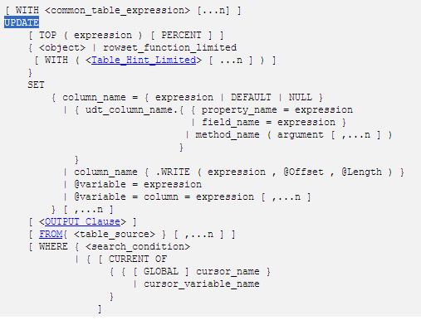
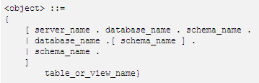
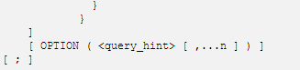
Update in SQL Server
指定将要更新的行数或行百分比。expression 可以为行数或行百分比。
返回单个值的变量、文字值、表达式或嵌套 select 语句（加括号）。expression 返回的值替换 column_name 或 @variable 中的现有值。
指定将表、视图或派生表源用于为更新操作提供条件。

Slide 76

Thanks for your attention

